Slide 1
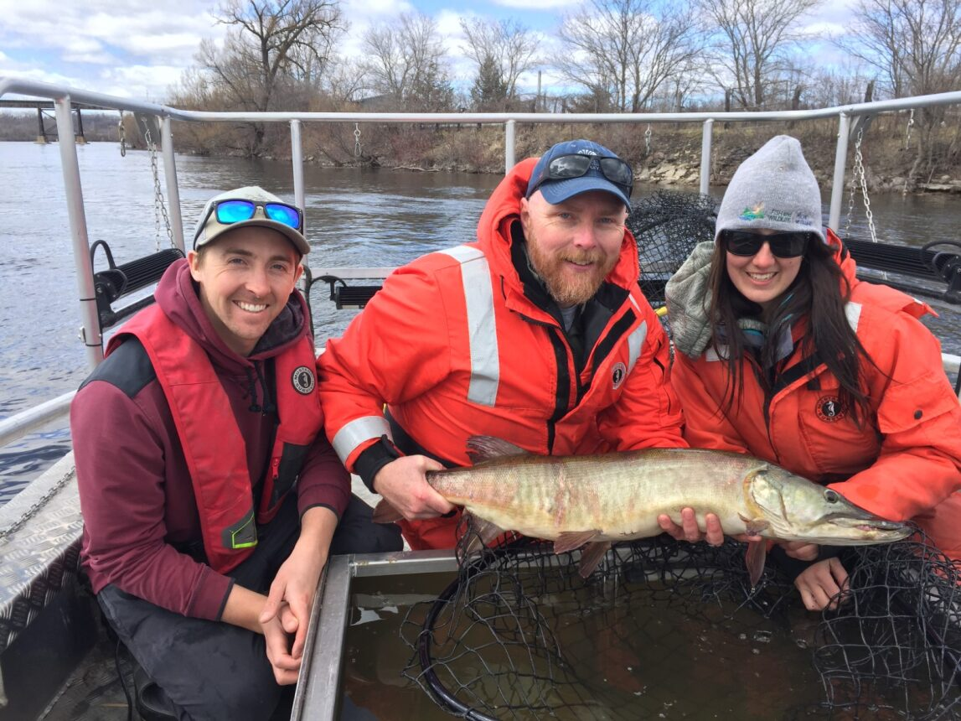
Trent River Muskellunge

Slide 2
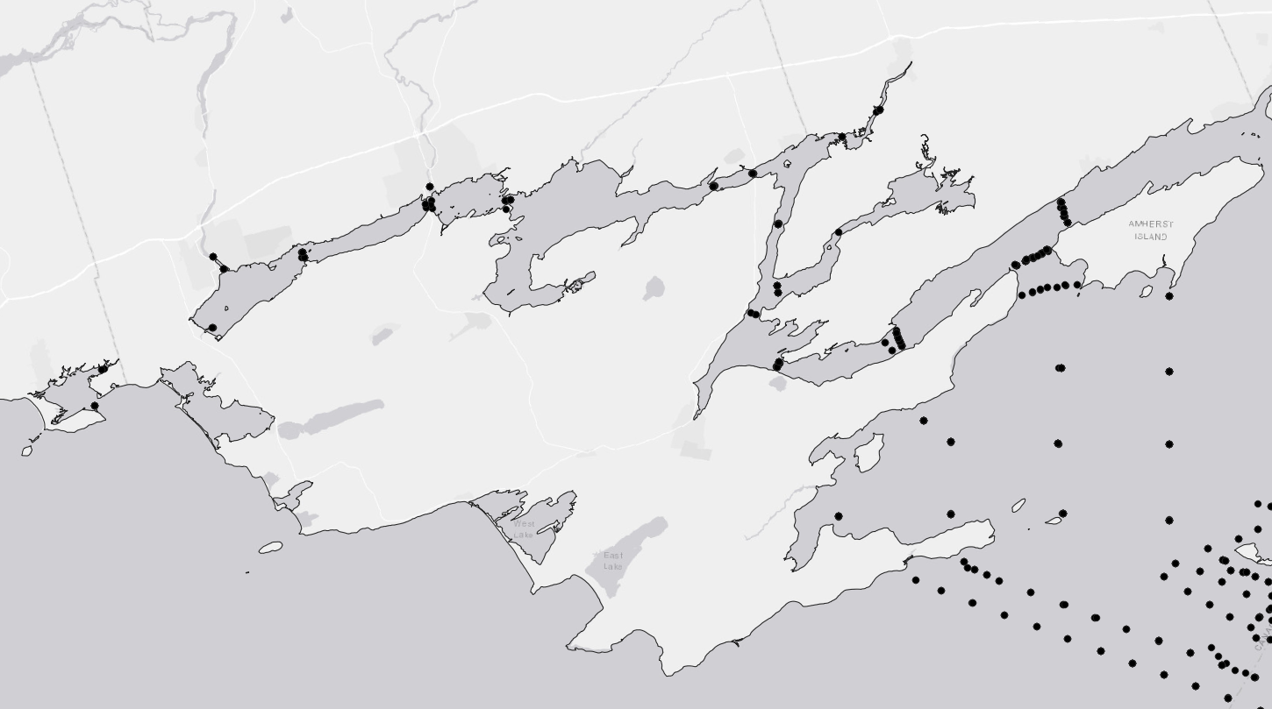

Slide 3
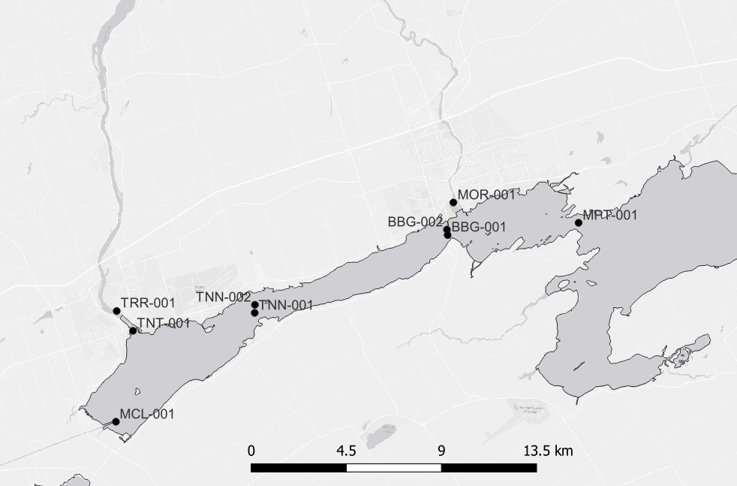

Slide 4
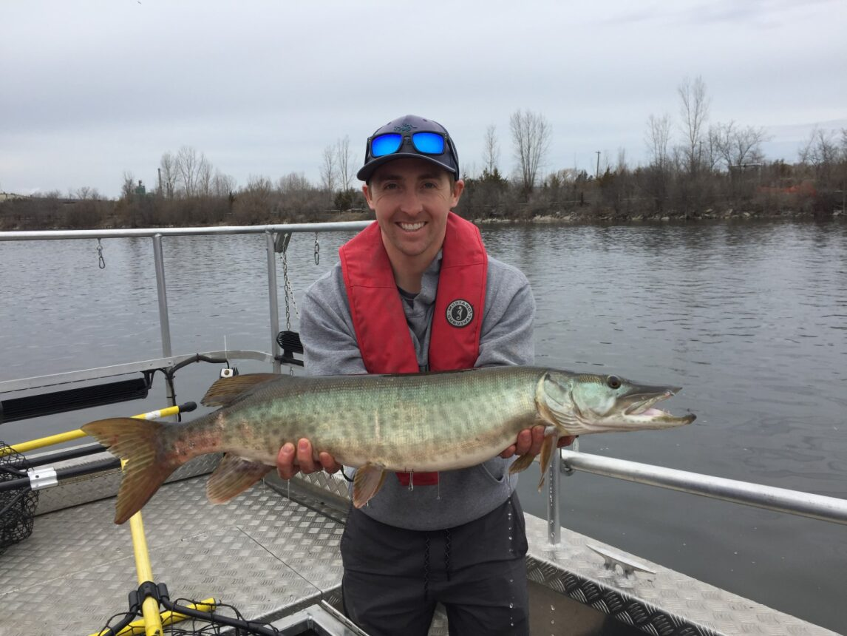
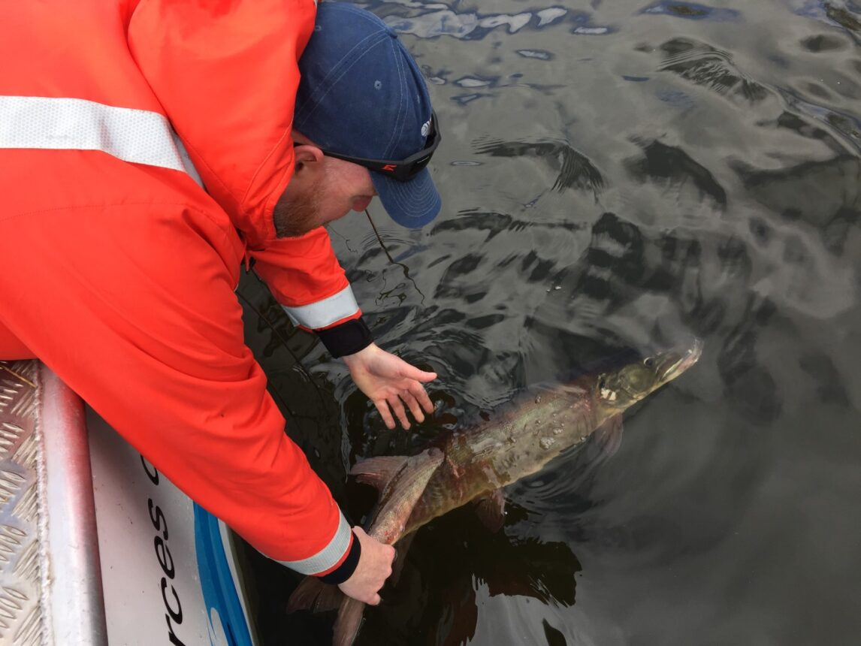
Animal ID | Fork Length (mm) | Total Length (mm) | Weight (g) | Tagging Date | Number of Days Detected
1 | 790 | 885 | 4520 | April 24, 2018 | 758
2 | 880 | 940 | 8520 | April 26, 2018 | 805
3 | 1008 | 1016 | 12670 | April 30, 2018 | 680
4 | 1100 | 1180 | 12060 | May 1, 2018 | 447

Slide 5
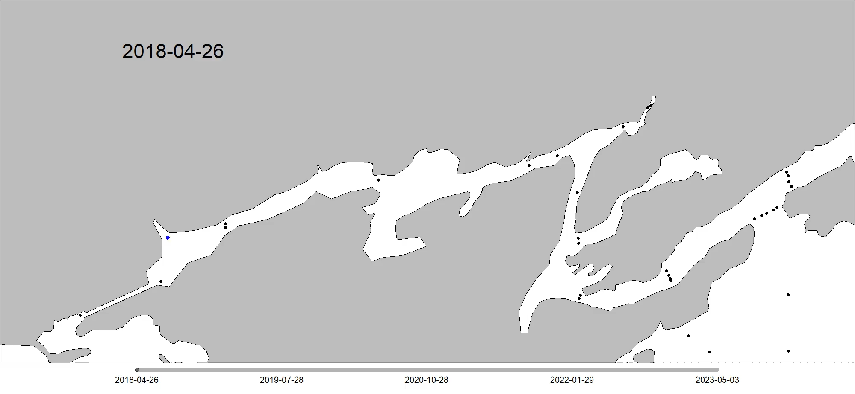

Slide 6
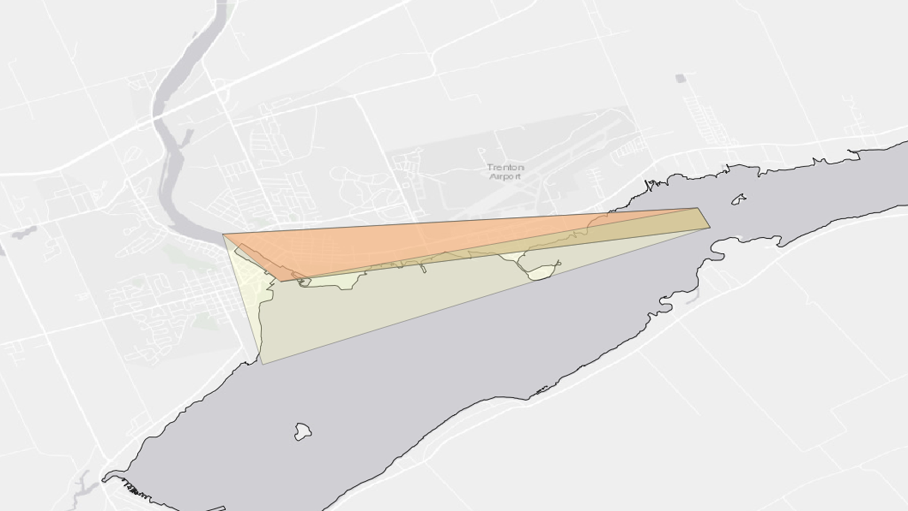
Home Range Estimate (95% MCP)

Slide 7
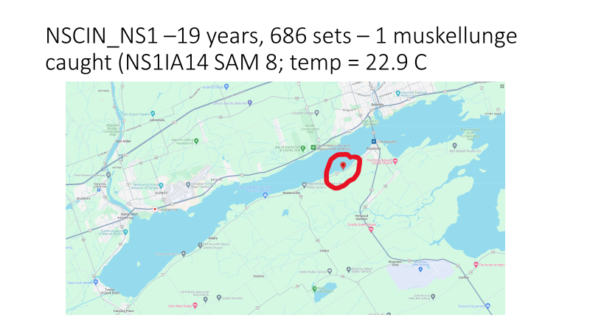

Slide 12
BQ WTP – Daily Temps – 20 years

Slide 13
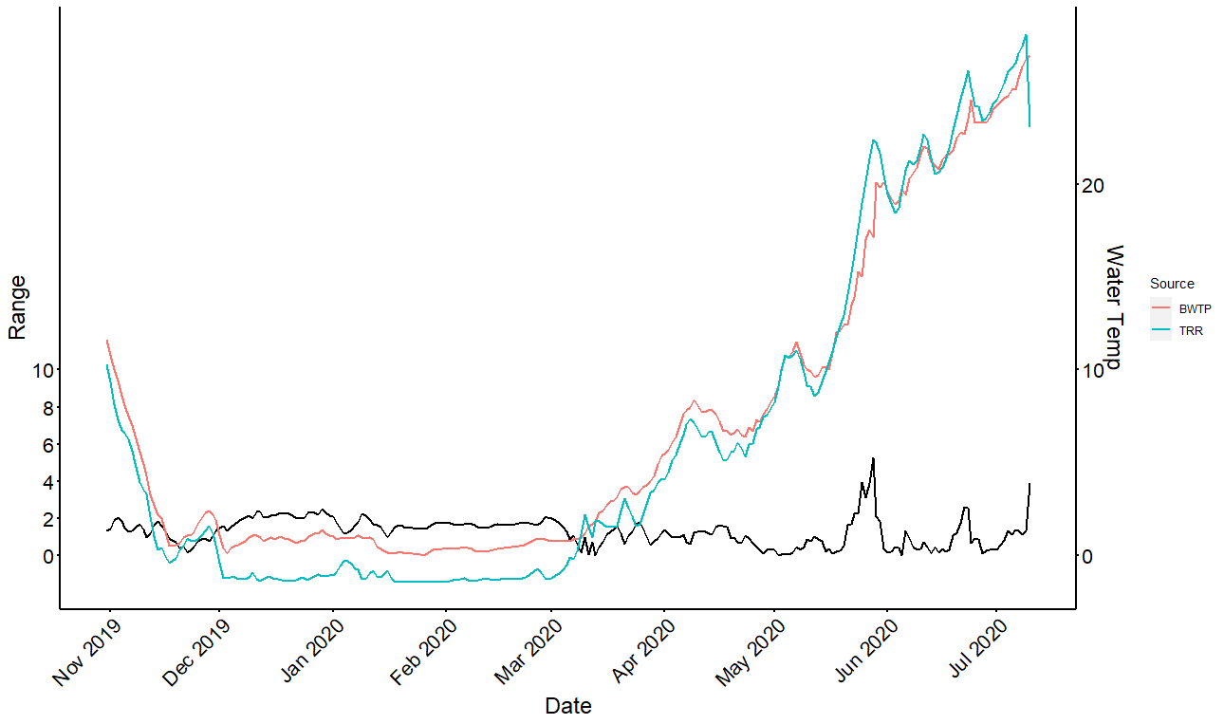

Slide 14
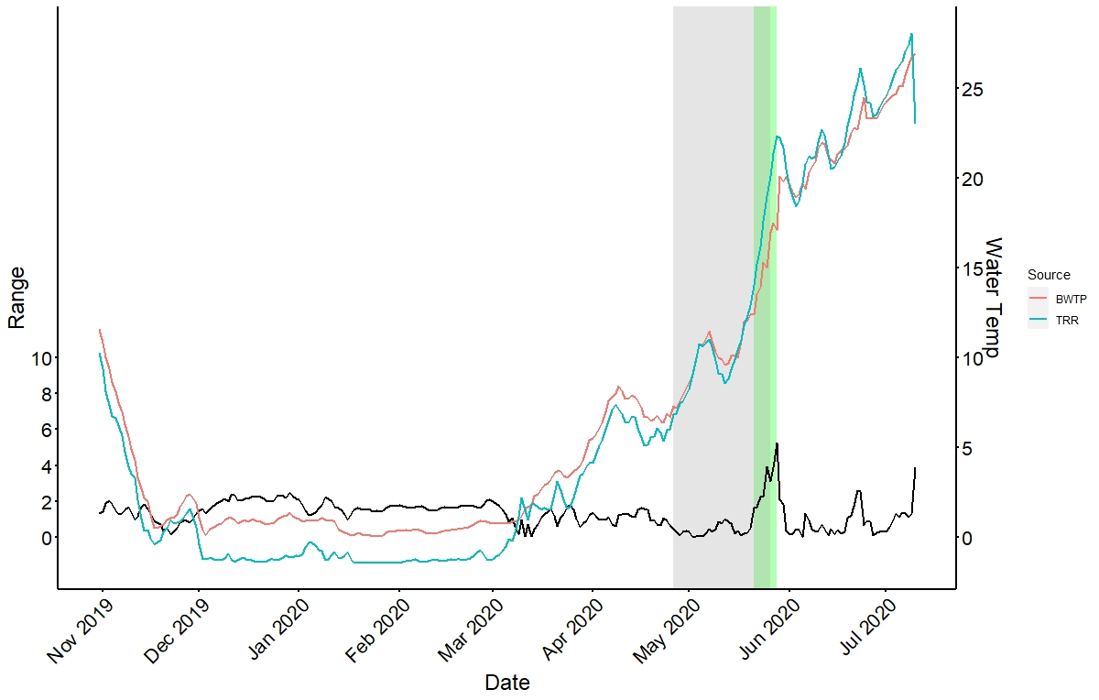
***
- Temperature range of spawning temperatures is 13.2 – 18.1 degrees C (Farrell 2001). (green)
- Eggs deposited at 7-17degrees but peaked at 10-13 (Farrell et al., 1996) (grey)
Notes:
In 2020 spawning temperatures were between 13.2 and 18.1 degrees from May 21st until May 28th.
In 2020 spawning temperatures were between 7 and 17 degrees from April 26th until May 26th.

Slide 20
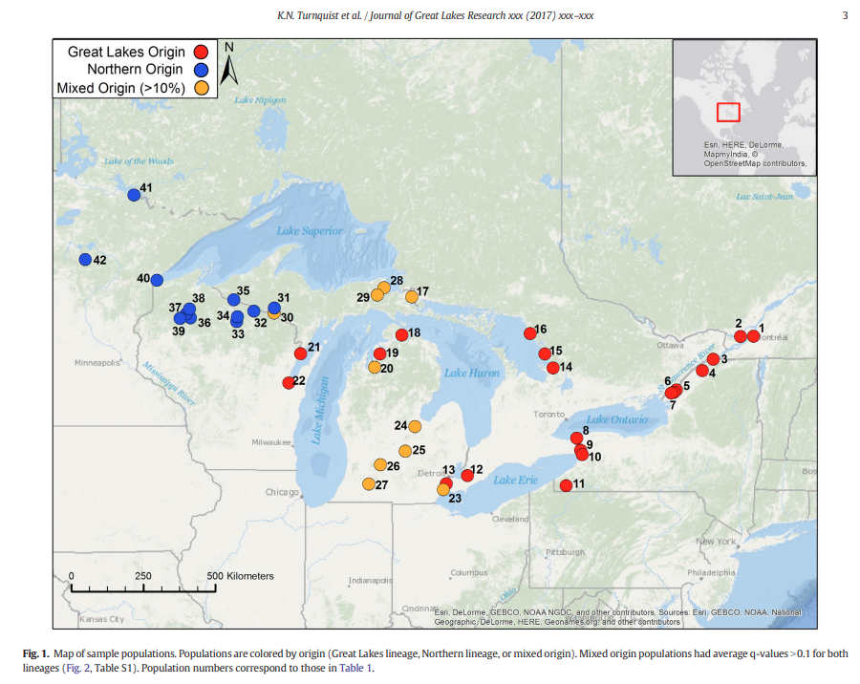

Slide 21
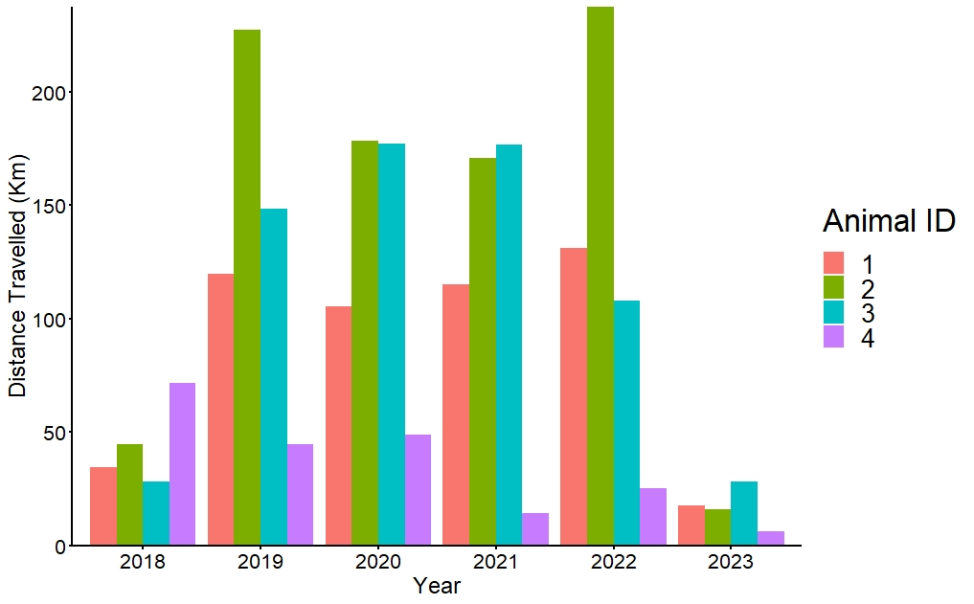
***Hourly estimates of position
Animal_ID | 2018 | 2019 | 2020 | 2021 | 2022 | 2023
1 | 34.53 | 119.59 | 105.29 | 115.33 | 131.33 | 17.77
2 | 44.73 | 227.09 | 178.26 | 170.79 | 237.47 | 15.85
3 | 28.40 | 148.24 | 177.11 | 176.87 | 108.14 | 28.44
4 | 71.88 | 44.73 | 48.75 | 14.42 | 25.17 | 6.42
***Note that 2018 and 2023 do not contain a full years worth of detections

Slide 22
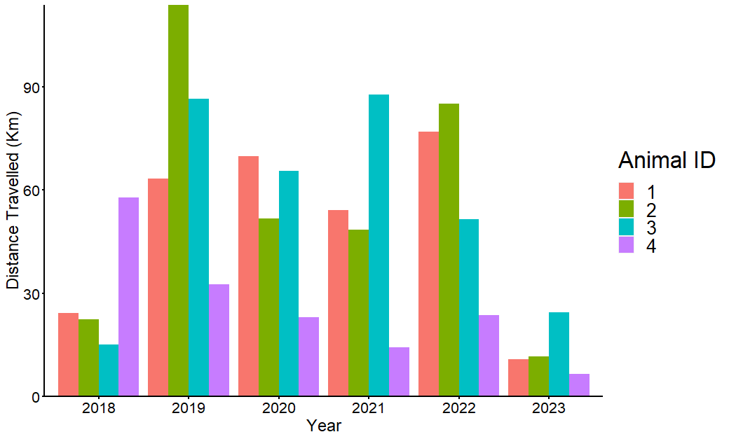
***Daily Estimates of Position
Animal_ID | 2018 | 2019 | 2020 | 2021 | 2022 | 2023
1 | 24.13 | 63.3 | 69.68 | 54.04 | 76.98 | 10.87
2 | 22.29 | 113.75 | 51.71 | 48.46 | 84.98 | 11.65
3 | 15.07 | 86.51 | 65.43 | 87.66 | 51.51 | 24.4
4 | 57.84 | 32.5 | 22.96 | 14.29 | 23.69 | 6.42
***Note that 2018 and 2023 do not contain a full years worth of detections

